Slide 1
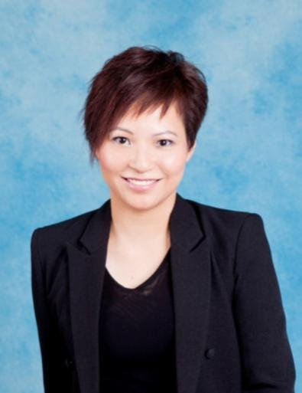
事業要素:招募 Fundamentals for Recruiting
Margaret Chan
總顧問經理級 National Supervising Coordinator
四個佣金週期共賺取HK$76,600
HK$76,600 in 4 Commission weeks
本簡報中提到的收入等級純屬舉例說明，無意代表美安香港經銷商的一般收入，也無意表示任何經銷商皆可賺取同等收入。美安香港經銷商的成功與否，取決於其在發展事業時的努力、才能與投入程度。The income levels mentioned in the following presentation are for illustration purposes only. They are not intended to represent the income of a typical Market Hong Kong Distributor, nor are they intended to represent that any given Independent Distributor will earn income in that amount. The success of any Market Hong Kong Independent Distributor will depend upon the amount of hard work, talent, and dedication which he or she devotes to building his or her Market Hong Kong Business.

Slide 2
事業要素 : 招募 Fundamentals for Recruiting

Slide 3
物色人選、招募人才 以及推薦新經銷商可以 1) 複製你的努力 2)有效運用你的時間！
Prospecting, Recruiting and Sponsoring can: 1) Duplicate your effort 2)Use your time effectively!
Notes:
3
3
3

Slide 4
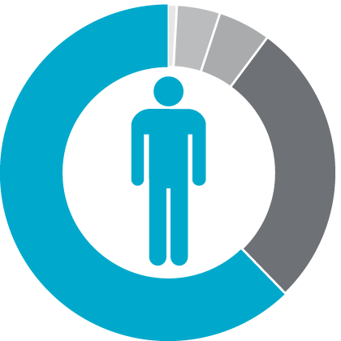
在年滿65歲的每100個人中…
For every 100 people who should have reached the age of 65...
4% 財務穩健
1% 富有
4% Financially Fit
1% Wealthy
5% 仍在工作
成為 5%
Become 5%
5% Still Working
62% 貧窮／身無分文
28% 已逝世
62% Struggling Financially
28% Dead

Slide 5
商業大使
Business Ambassador

Slide 6
招募 ≠ 物色 先物色，後招募
Recruiting ≠ Prospecting
First Prospecting, Then Recruiting

Slide 7
甚麼是物色？
評估對方是否需要
評估對方是否適合
評估對方是否想要
你是評估還是憑個人感覺？
物色是一個評估人才的過程
What is Prospecting?
Evaluate if he has the need
Evaluate if he is the right person
Evaluate if he wants it
Are you evaluating or just base on feeling?
Prospecting is a process of evaluation.

Slide 8
如果物色那麼重要，
那你要的是2個人還是2個通路？
If prospecting is so important, then do you want just 2 people or 2 organizations?
合作 + 借力
Cooperation + Leverage the Power

Slide 9
那麼，你要的是2個通路還是 2個主動運作通路？
So, do you want simply 2 organizations OR 2 organizations which run proactively?
穩定
Stable
積極主動
Proactive

Slide 10
建立關係
跟「自己」建立關係
跟「公司」建立關係
跟「潛在人選」建立關係
Building Relationship
Building Relationship with “Yourself”
Building Relationship with “Company”
Building Relationship with “Potential Partners”

Slide 11
評估「合格夥伴」貼士
1. 正尋找改變現在或未來財務狀況
2. 良好溝通技巧
3. 人脈連繫
4. 具備基本電腦知識
5. 財務條件符合資格
TIPS on evaluating “Qualified Individuals”
Looking for a vehicle to improve their current and/or future financial position
Good communication skills
Well connected
Basic computer skills
Financially qualified

Slide 12
物色方法
1. 產品法
起步 | → | 潛在人選 | → | 顧客 | → | 忠誠顧客 | → | 夥伴
起步
顧客
忠誠顧客
2. 商機法
潛在人選
夥伴
起步 | → | 潛在人選 | → | 夥伴 | → | 使用產品
起步
潛在人選
夥伴
使用產品
起步 | → | 潛在人選 | → | 使用產品 | → | 夥伴
複製流程
起步
潛在人選
使用產品
夥伴
Ways of Recruiting
1. Introducing Products
Getting Started | → | Prospect | → | Customer | → | Loyal customer | → | Partner
Getting started
Potential Ind.
Loyal customers
Customers
Partners
2. Evaluation of Business Opportunity
Getting Started | → | Prospect | → | Partner | → | Use product
Getting started
Getting Started | → | Prospect | → | Use product | → | Partner
Potential Ind.
Partners
Use the products
Duplicate the Process
Getting started
Potential Ind.
Use the products
Partners

Slide 13
招募是一個彼此交流的過程
引導商業思維
消費轉投資
45年計劃
M 型社會
後備計劃
入門網站
夥伴商店
現金回贈
合作代替競爭 (MPCP 優勢)
趨勢(網上行銷)
產品代理優勢
一對一行銷威力
社交購物
分析商機 VS 說服別人
Recruiting is a process of people interaction
Lead to Business Mindset
Shopping Annuity
45-year plan
M-shape society
Back-up plan
HK.SHOP.COM
Partner stores
Cashback
Cooperation instead of competition (Pros of MPCP)
Trend (Internet Marketing)
Pros of Product Brokerage
Power of One-to-One Marketing
Social Shopping
Evaluation of Business Opportunity VS Persuade People

Slide 14
Leverage your Effort (Tools)
借力(工具篇)
入門網站 (香港、台灣、澳洲、美國、全球)
迷你網站 (Motives®)
22 分鐘超連鎖™事業商機短片
超連鎖™事業簡報會
會議聯盟系統
起步指南
年報
產品目錄
居家購物清單
SHOP.COM (HK、TW、AU、US 、Global)
Mini-websites (Motives®)
22 minutes UBP Video
UBP
NMTSS
Getting Started Guide
Annual Report
Product Catalog
Home Shopping List

Slide 15
疑問處理
Questions Handling
Feel Interest and understand
有興趣繼續了解
「會議」接「會議」
“Meeting” after “Meeting”
答案盡在
業績管理紅利計劃MPCP內
Answers are all in MPCP

Slide 16
定位 :
分析商機 VS 說服別人
態度 :
誠懇、有耐性、不卑不降
心態 :
所有結果都是好的結果
招募的「過程」比「結果」更重要
Positioning :
Analyze business opportunity VS Persuading
Attitude :
Sincere, Patient, Humble
Mentality :
All results are good
The recruiting “Process” is more important than the “Result”

Slide 17
見證分享
Testimonials

Slide 18
加盟前 :
介紹Motives®
Motives®美麗盛會
產品目錄
Motives® Workshop
介紹HK.SHOP.COM入門網站
22 分鐘超連鎖™事業商機短片
疑問處理
Dolly Lee
介紹 : 台灣人、新娘化妝師、平面設計師
Intro: from Taiwan, Bridal make-up artist, Graphic designer
Before joining mhk:
Introduce Motives®
Motives® Night
Product Catalog
Motives® Workshop
Introduce HK.SHOP.COM
22 mins UBP video
Questions handling

Slide 19
Koiee Law
加盟前 :
介紹HK.SHOP.COM入門網站
22 分鐘超連鎖™事業商機短片
超連鎖™事業簡報會
夥伴商店會議
網路中心會談
Motives® Workshop
產品目錄
疑問處理
營養產品UMO
介紹 : 香港人、花藝師、花藝培訓及花藝企業 培訓導師、傳統生意老闆
Intro: from HK, Floral designer, Floral Corporate Trainer, Boss of traditional business
Before joining mhk:
Introduce HK.SHOP.COM
22 mins UBP video
UBP
Partner Store Conference
WebCenter Sales Appointment
Motives® Workshop
Product Catalog
Questions handling
Product Training, UMO

Slide 20
一對一行銷
有原則、有方法、有彈性
One-to-One Marketing
Principle、Solutions、Flexible

Slide 21
嶄新的公司，嶄新的機會，嶄新的你
2014美安香港年會
mhk Annual Convention
#MHKAC2014

